Slide 1

Semantic Segmentation
Thierry Pécot
Research Associate
Translational Science Lab
Chan Zuckerberg Initiative Imaging Scientist

Slide 2
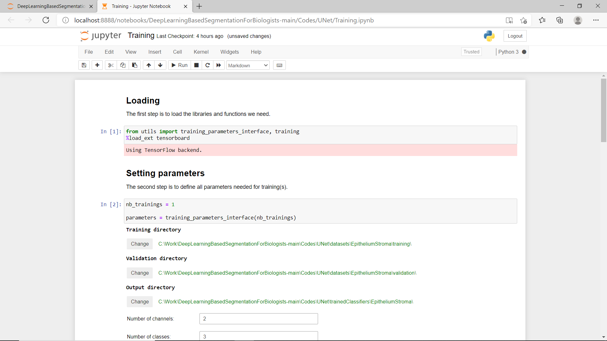
Jupyter Notebook
Currently running
Programming language
Processed or stopped
Text panels
Code panels

Slide 3
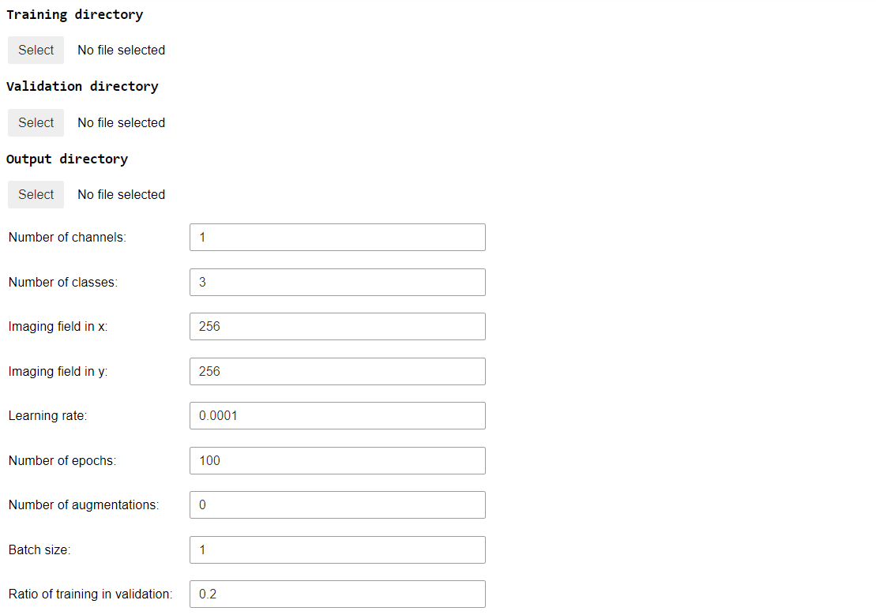
Training
Location of training dataset
If no validation directory is indicated, train_to_val_ratio of training dataset is randomly selected to define a validation dataset
Location of validation dataset
Location of trained model
Number of channels in images
Number of output classes
Size of input image patches used for training
If inferior to image size, a random location inside the image at each iteration is defined
Learning rate
Number of epochs
Each image or batch of images is considered as 1 iteration
All images in the training dataset correspond to 1 epoch
Number of augmented image for each image in the training dataset
Number of images processed at once

Slide 4
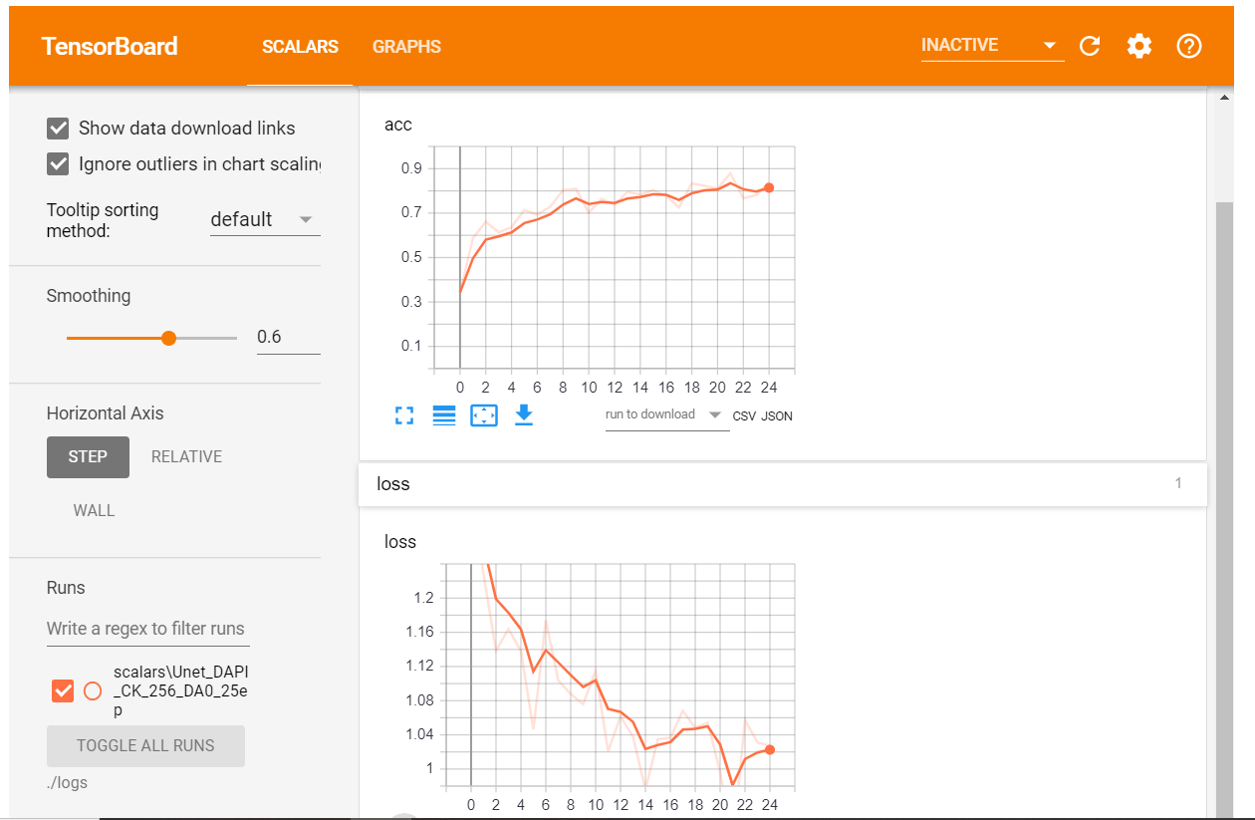

Slide 5
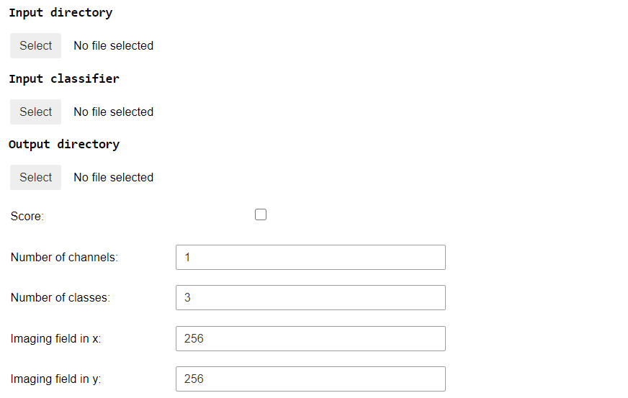
Running
Location of images to be processed
Location of trained classifier
Location for processed images
Score between 0 and fo 1 for each class if checked
1 class defined at each pixel if unchecked
Number of channels of images to be processed
Number of output classes
Size of input image patches used during training

Slide 6
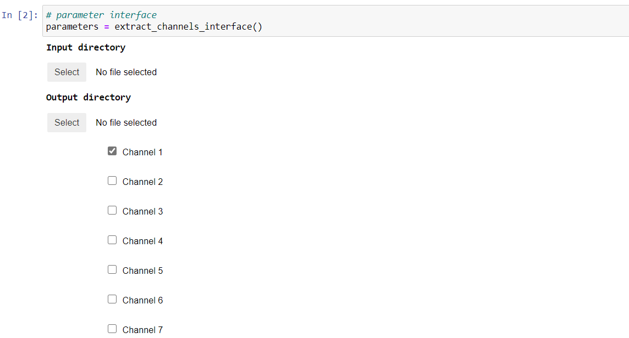
PreProcessing

Slide 7
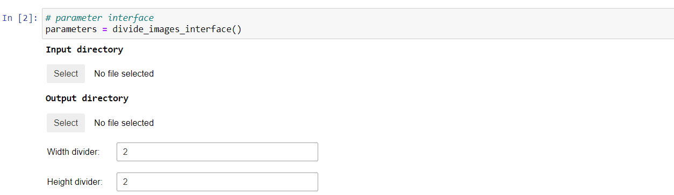
PreProcessing

Slide 8
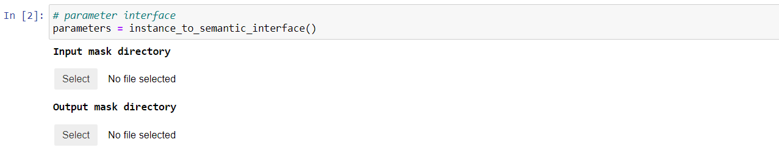
Semantic to Instance Segmentation
Preprocessing: convert from different intensity for each object to 3 classes: objects, object contours and background

Slide 9
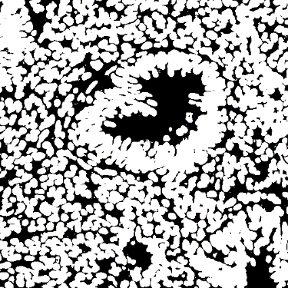
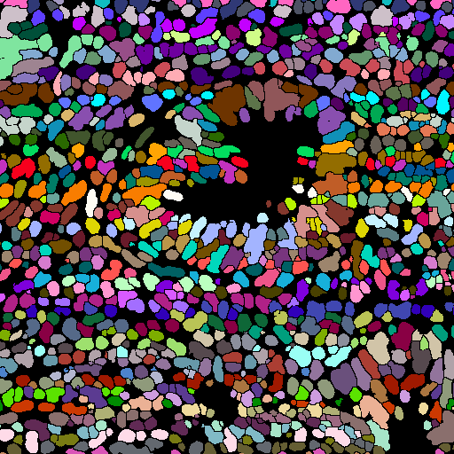
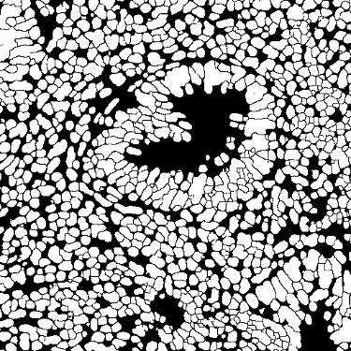

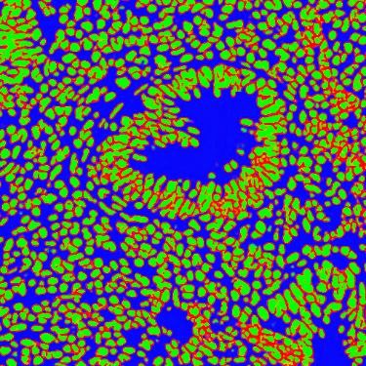
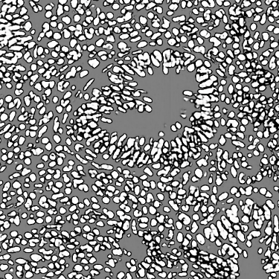
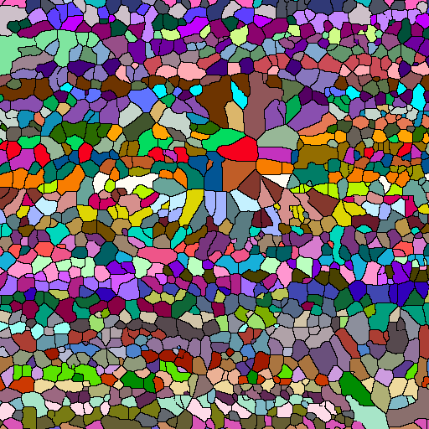
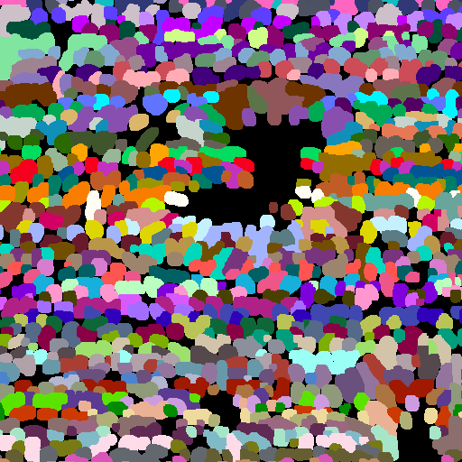
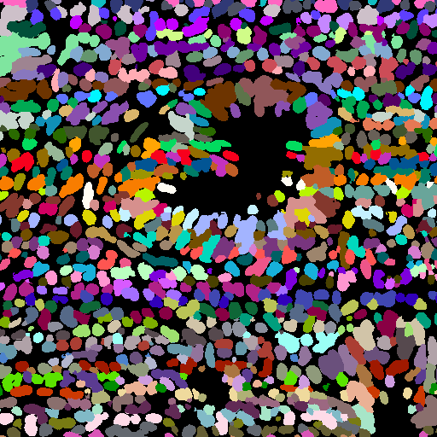
Semantic to Instance Segmentation
Individual nuclei without contours
Binary nuclei without contours
Object component
Contours to add
-
Postprocessing: convert from 3 classes to different intensity for each object
*
+
Scores
*
+
Nuclei minus contours
Voronoi tesselation
Dilated nuclei without contours
Individual nuclei

Slide 10
Video Tutorials
Epithelium/stroma segmentation:
    Data preparation
    Training
    Processing
Nuclei segmentation:
    Data preparation
    Training
    Processing

